Slide 1
KHU Automatic Observing Software
for McDonald 30 inch Telescope (KAOS 30)
Development Document
- v2.0 -
IR Lab
Software team

Slide 2
Revision Summary
Version | Date | Revision Description
1.0 | 2017-07-13 | Created the development document of Automatic Observing Software.
1.1 | 2017-07-14 | Software requirements, function definition.
1.2 | 2017-07-18 | Operation sequence for Auto-focusing, Script Mode.
1.3 | 2017-07-21 | Deployed layout, function definition, operation sequence, appendix.
1.4 | 2017-07-25 | Appendix A for naming of member variables.
1.5 | 2017-07-26 | Deployed layout, appendix A for naming of member variables.
1.6 | 2017-08-09 | Appendix C for observation log list, Fits header list.
2.0 | 2017-10-17 | New organization including the current status of KAOS30.

Slide 3
Contents
Introduction
Hardware Requirements
Software Requirements
System Architecture
Operation Sequence
Function Definition
Design for Graphical User Interface (GUI)
Development History
Remaining Tasks
Appendix. A : Naming & Coding Style for Visual C++
Appendix. B : Communication between class / dialog / exe
Appendix. C : Observation log list, Fits file header list

Slide 4
1. Introduction
Automatic observing is the most efficient system for sky surveys that image many targets over large areas of the sky. The system requires that integrates and operates astronomical instruments.
Dome
Telescope (Mount)
Camera
Filter wheel
Focuser
Such as Supernova, GRB...
Repeatedly monitoring over large area.
★ Advantages
Faster observation response times.
Eliminates the need for an observer to be constantly present.
Weather
monitoring
Automatic
observing
★ Disadvantages
Risk of accident (e.g., weather condition)
Need for automatic alarm and stop process!

Slide 5
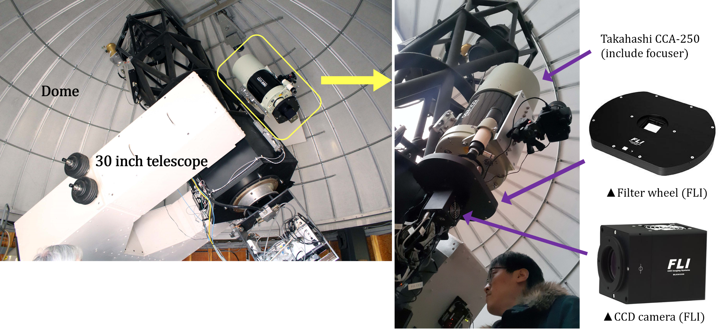
1. Introduction
In February of 2017, we installed a wide-field 10 inch telescope for Supernovae survey on the McDonald 30 inch telescope as a piggyback system.

Slide 6
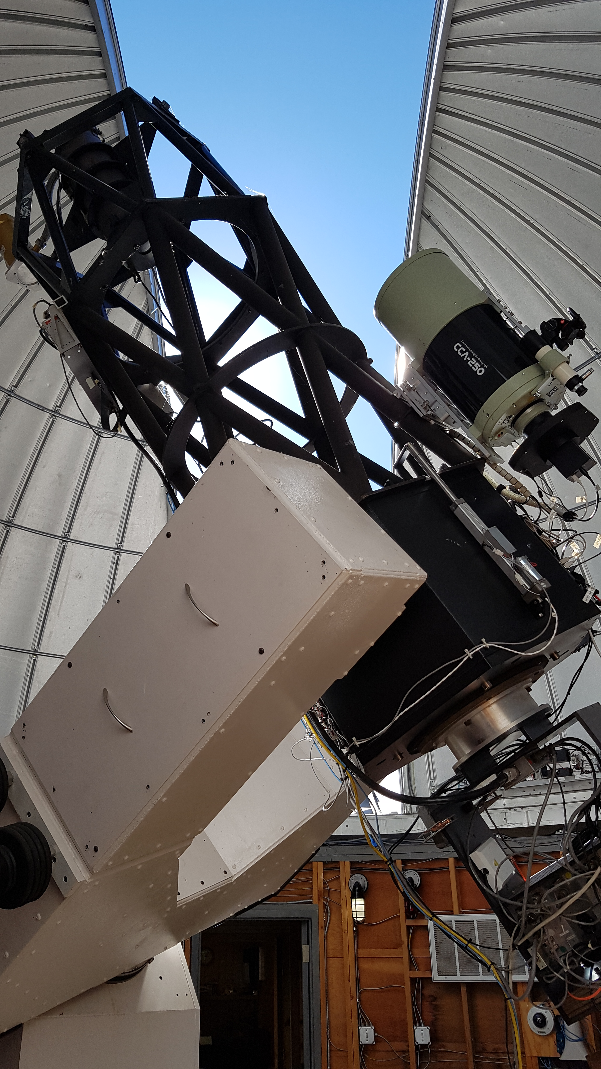
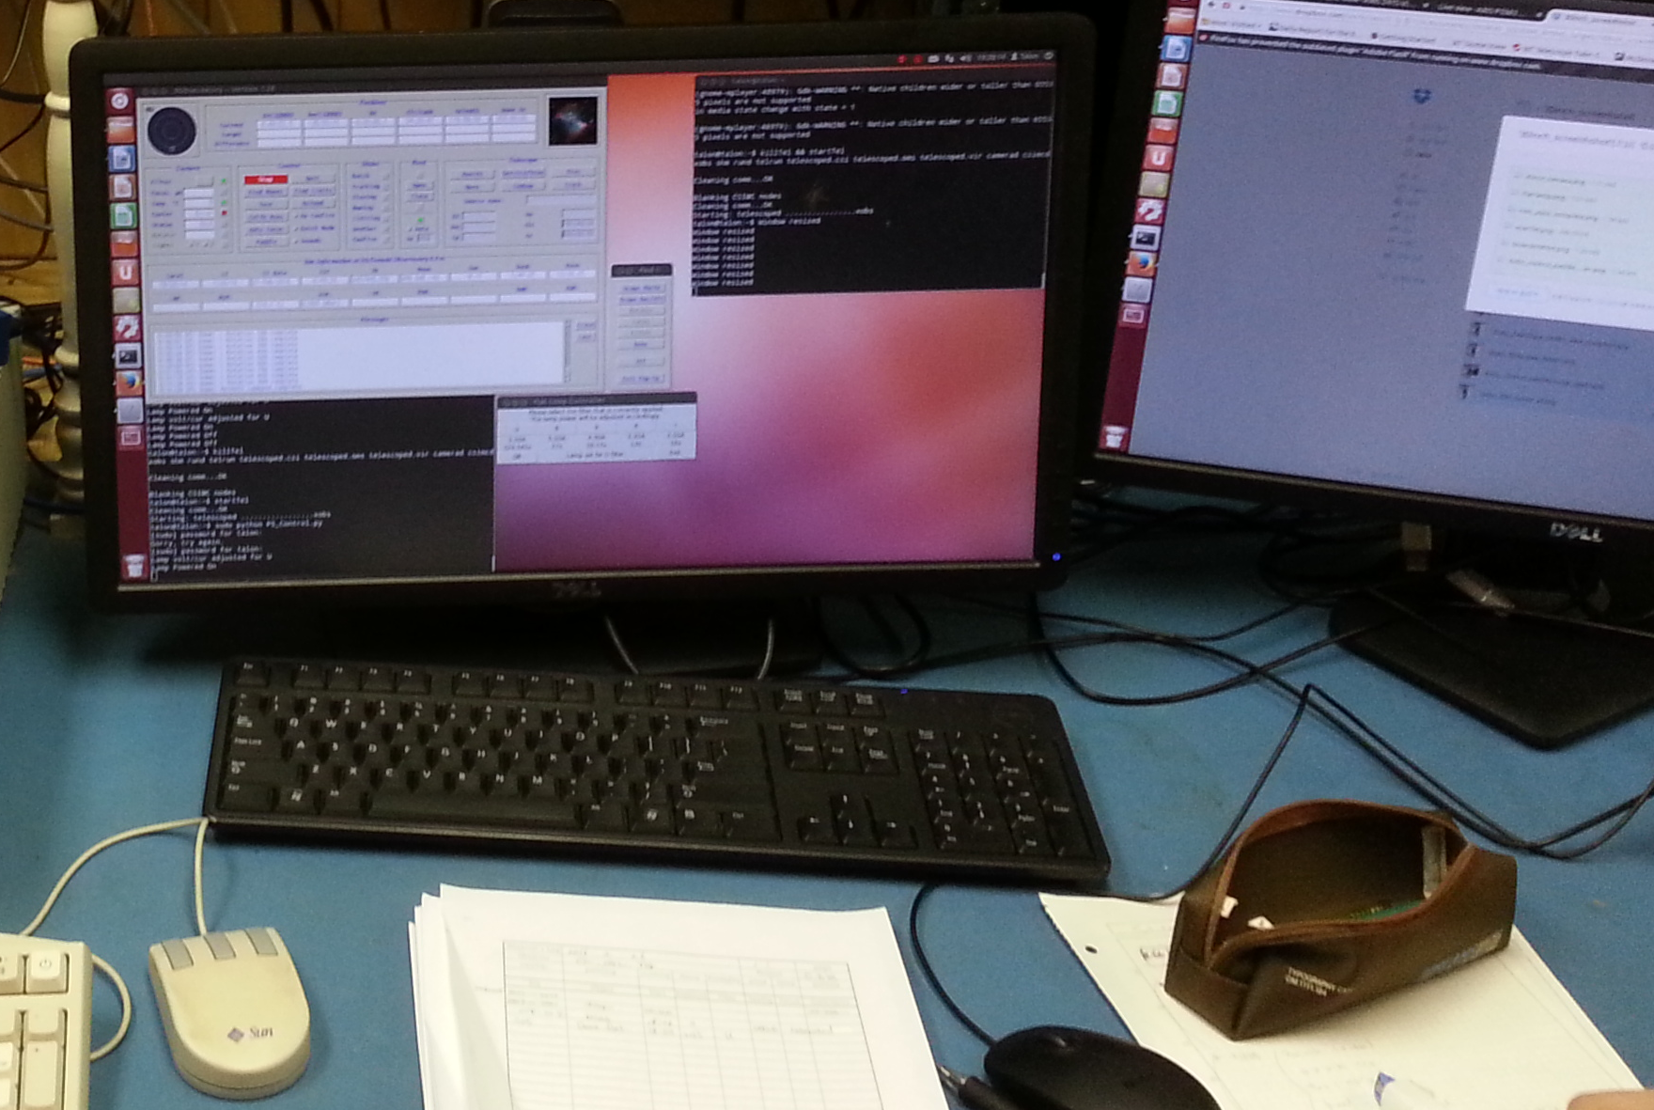
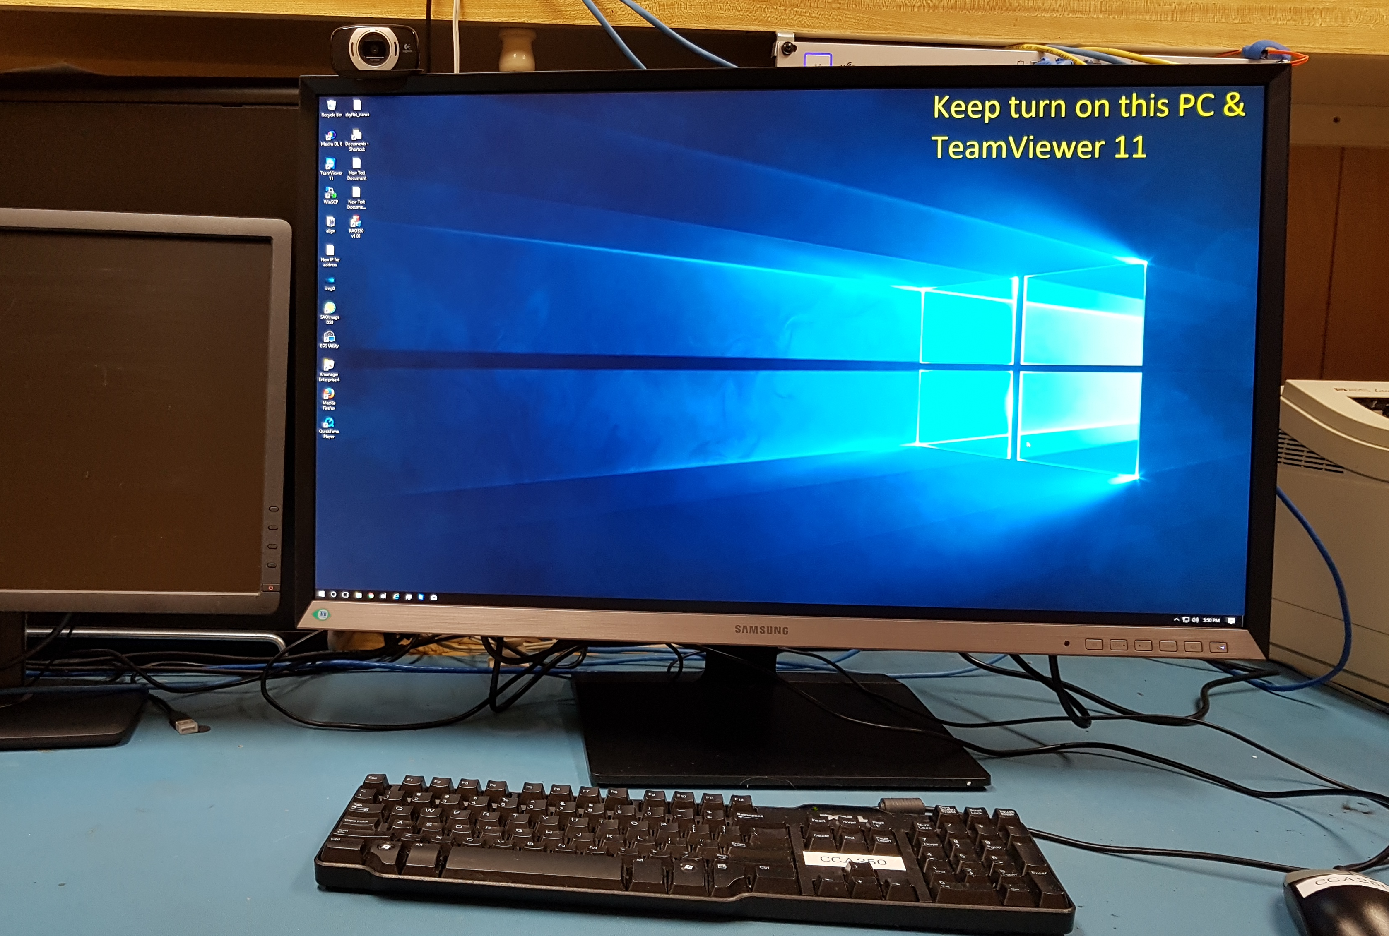
1. Introduction
However, during the observations, information such as target coordinates could not be exchanged with the telescope mount. The reason is the program that controls the telescope control system (TCS) and the program that controls the imager operate on independent PCs.
Dome
Talon PC
(Linux)
30inch Telescope
+ Piggy Back
30 inch
Telescope
Piggyback
Windows PC

Slide 7
1. Introduction
KAOS30 is an integrated observing software developed to improve this environment. The software is based on Visual C ++ and runs on the Windows operating system.
Existing operation systems
New operation systems with KAOS30
User
User
Talon PC (Linux)
Windows PC
KAOS30
Windows PC
TCS
Maxim DL
Talon PC (Linux)
TCS
Camera
Filter
Focuser
Weather
Monitoring
Telescope
Dome
Camera
Filter
Focuser
Telescope
Dome

Slide 8
2. Hardware Requirements
The hardware for the automatic observing system is consist of four devices as follows.
◈ TCS
30inch Telescope
Dome
◈ Focus
Takahashi Active Focus with CCA-250
◈ Camera
FLI ML16803
◈ Filter
FLI CL-1-10

Slide 9
2. Hardware Requirements
◈ 30 inch Telescope
Diameter = 767mm
Focal length = 2290mm
F-ratio = 3.0
Type = Cassegrain
◈ Dome
Diameter = 6.1m
◈ TCS
Operating system : OCAAS for Linux

Slide 10
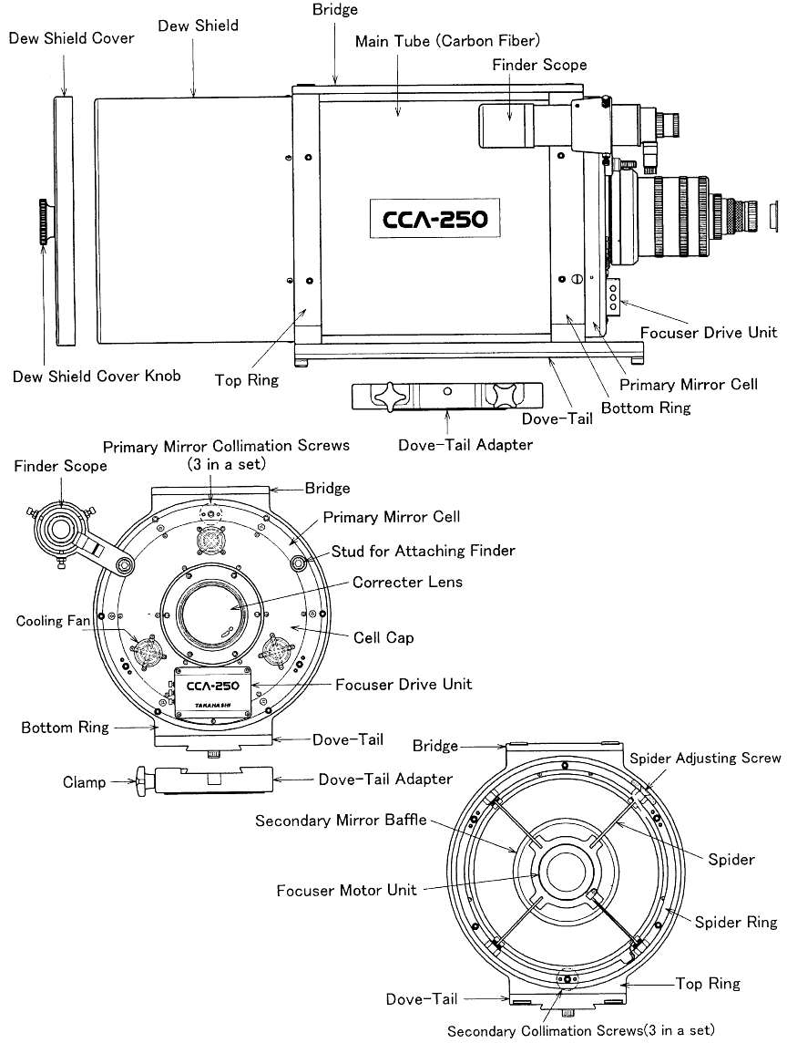
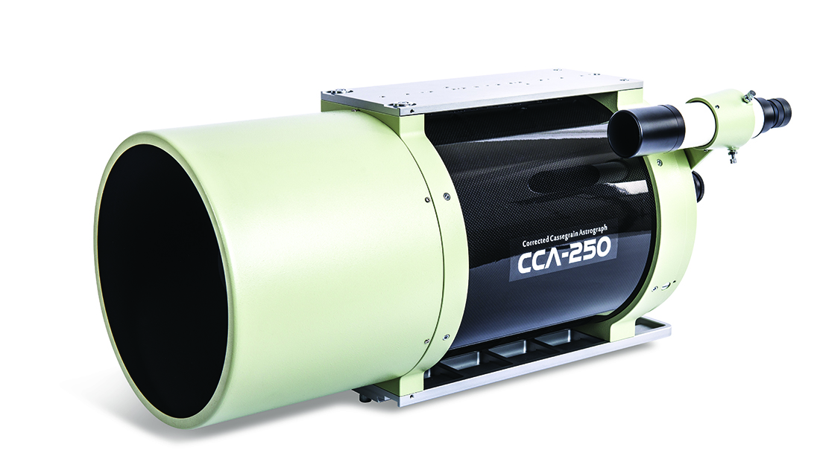
2. Hardware Requirements
◈ Takahashi CCA-250
Diameter = 250mm
Focal length = 890mm (With 0.72x 645 reducer)
F-ratio = 3.6
Type = Corrected Cassegrain

Slide 11
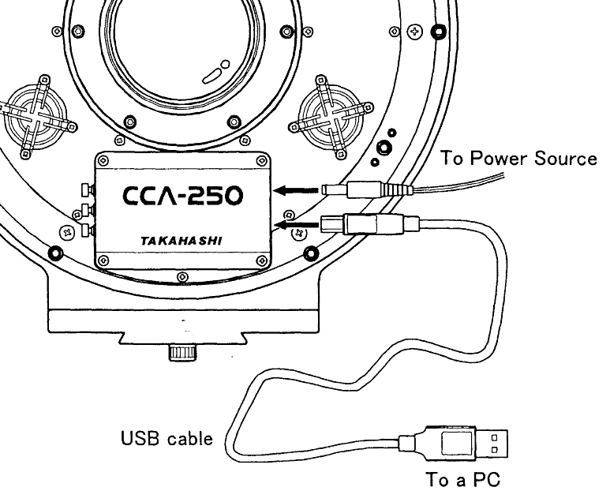
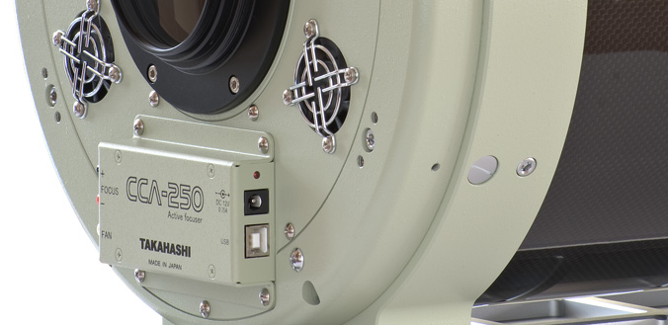
2. Hardware Requirements
◈ Active Focus - Takahashi CCA-250
Max Input Pulse = 192306 Pulse
Step Resolution = 10mm / 192306 Pulse
= 0.00052mm(0.052μm)
Interface : ASCOM driver

Slide 12
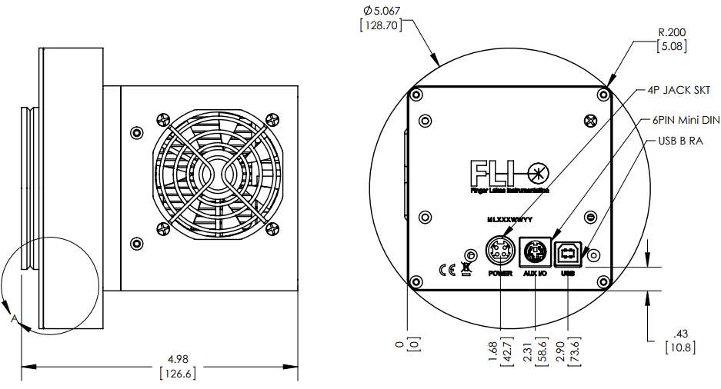
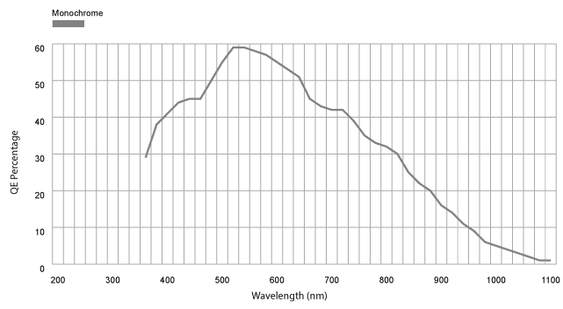
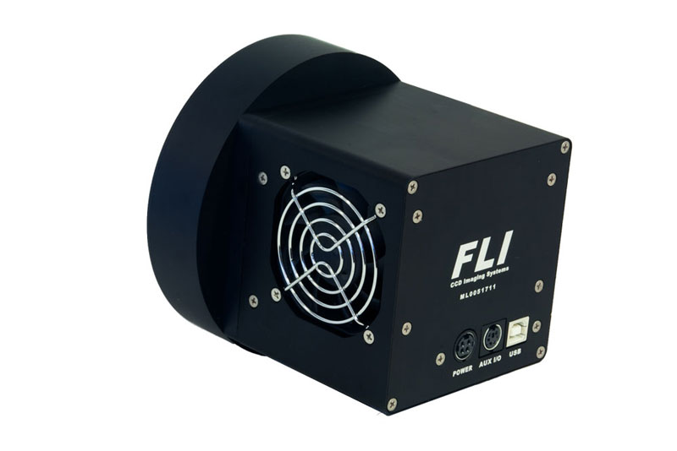
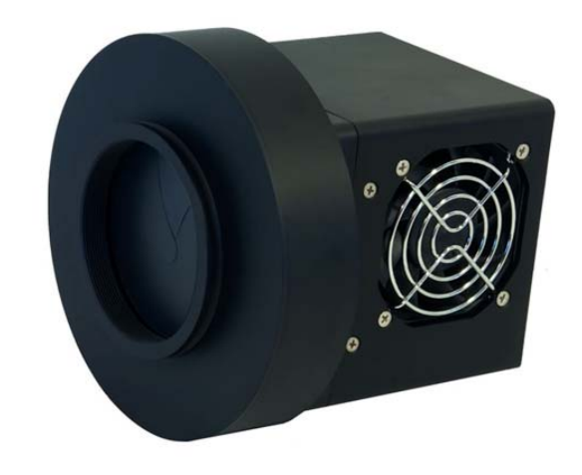
2. Hardware Requirements
◈ FLI ML 16803 w/ 65mm Shutter
Sensor = On Semi KAF-16803
Sensor Size = 36.8mm × 36.8mm
Pixel = 4096 × 4096
Pixel Size = 9μm
Field of View = 2.34˚ × 2.34˚ (with CCA-250)
Digitization Speed : 1 MHz and 8MHz
Interface : USB driver with FLI SDK

Slide 13
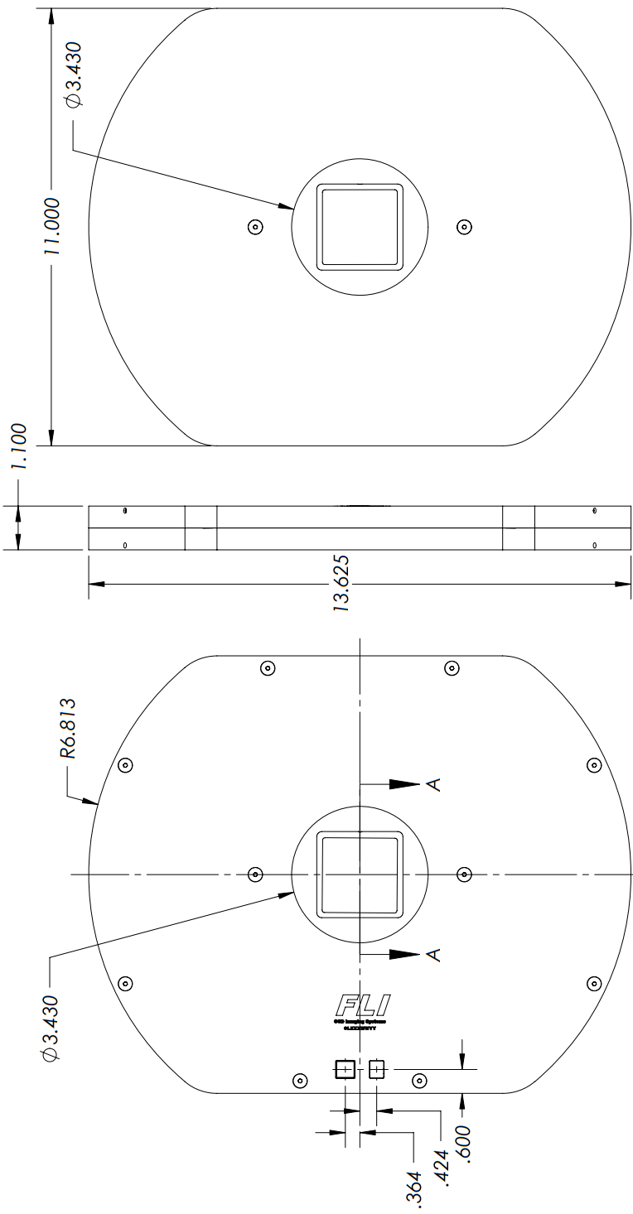
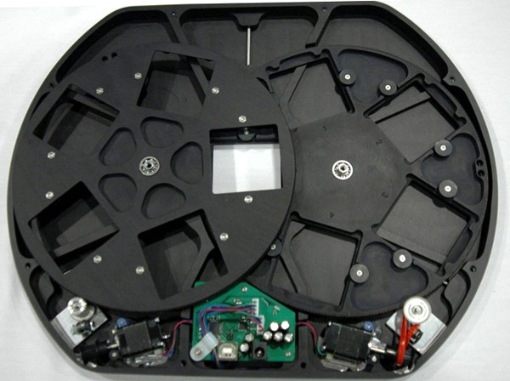
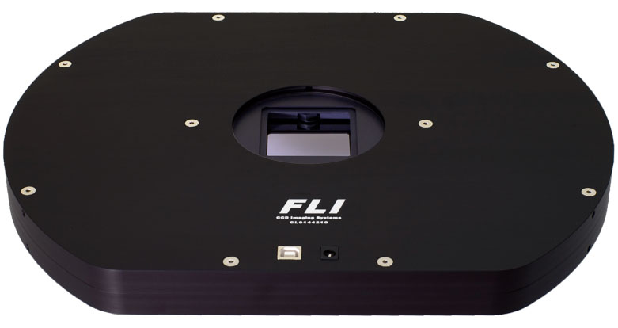
2. Hardware Requirements
◈ FLI CL-1-10
Filter Positions = 8 + 2 Open Positions
Filter Size = 50mm square (±0.125mm)
Thickness Range = 1.0 – 5.0mm
Interface : USB Driver with FLI SDK

Slide 14
3. Software Requirements
Packages distinguished by main functions of KAOS30
★ Telescope Control Package (TCP)
- Real-time interworking of 30 inch Telescope & Dome
- Automatic stop process via weather monitoring
★ Data Acquisition Package (DAP)
- Science data acquisition
- Display & Analysis of Image data
★ Auto Focus Package (AFP)
- Focus adjustment (Manual / Auto)
★ Script Mode Package (SMP)
- Enable automatic observation

Slide 15
3. Software Requirements
Detailed features required for each package
★ Telescope Control Package (TCP)
(1) Real-time interworking of 30 inch Telescope & Dome
- Connect/Disconnect Telescope & Dome
- Parking Telescope
- Open/Close/Parking Dome
- Get/Set Position : right ascension(R.A), declination(Dec.), Dome angle
- Automatic adjustment of dome position to telescope field of view
- Emergency stop process
(2) Automatic stop process using weather monitoring
- Obtain weather information
- Alarm process based on weather policy

Slide 16
3. Software Requirements
Detailed features required for each package
★ Data Acquisition Package (DAP)
(1) Science data acquisition
- Connect/Disconnect FLI Camera & Filter wheel
- Check Camera/Filter Status
- On/Off Cooler for CCD cooling
- Exposure settings for science imaging (Full/Sub frame)
- Start/Abort Exposing
- Change position of filter wheel
- Modify the list of filter wheel
- Save the standard Fits file
- Save the observation log
(2) Display & Analysis of Image data
- Display image with z-scale
- To measure the astronomical seeing (2-D Gaussian fitting)

Slide 17
3. Software Requirements
Detailed features required for each package
★ Auto Focus Package (AFP)
(1) Focus adjustment (Manual)
- Connect/Disconnect CCA-250 Auto-focuser
- On/Off Cooler for focuser cooling
- Get/Set Focus position
- Exposure settings for focus imaging (Sub frame)
- To measure the astronomical seeing (2-D Gaussian fitting)
- Save the adjustment log
(2) Auto-Focus adjustment
- Start/Abort Auto-focusing
- Finding the best focus at minimum seeing through sequential shooting
(CFitMRQ Poly)

Slide 18
3. Software Requirements
Detailed features required for each package
★ Script Mode Package (SMP)
(1) Enable automatic observation
- Save/Load Script files in text format
- Set telescope/focus/filter position
- Exposure settings for science imaging
- Set iteration number
- Start/Stop Script mode

Slide 19
3. Software Requirements
Script Mode Package (SMP) supports automatic observing via script mode.
★ Individual functions
SetFrameType
SetFilter
SetExposureTime
…
StartExposure
StartLoop
EndLoop
# : comment
e.g.)
SetFrameType object
SetFocus 21311
SetFilter V
SetExposureTime 3
StartLoop NGC0628 1
StartExposure
EndLoop NGC0628
Telescope movement, dome operation, etc. can also be added.

Slide 20
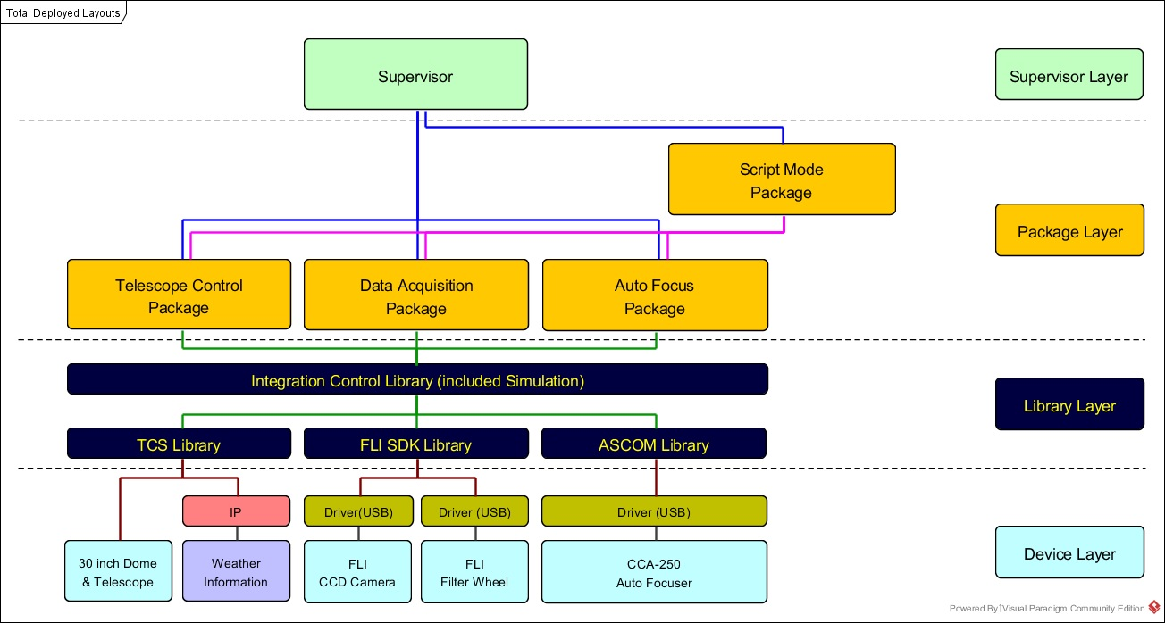
4. System Architecture (Domain Engineering Process)

Slide 21
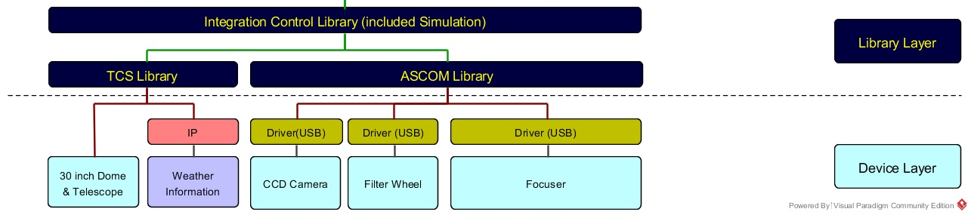
4. System Architecture (with ASCOM)
ASCOM is an integrated driver platform developed to standardize the interfaces of astronomical instruments. If the device of manufacturer supports the ASCOM driver, it can be applied immediately without modification of the code.

Slide 22
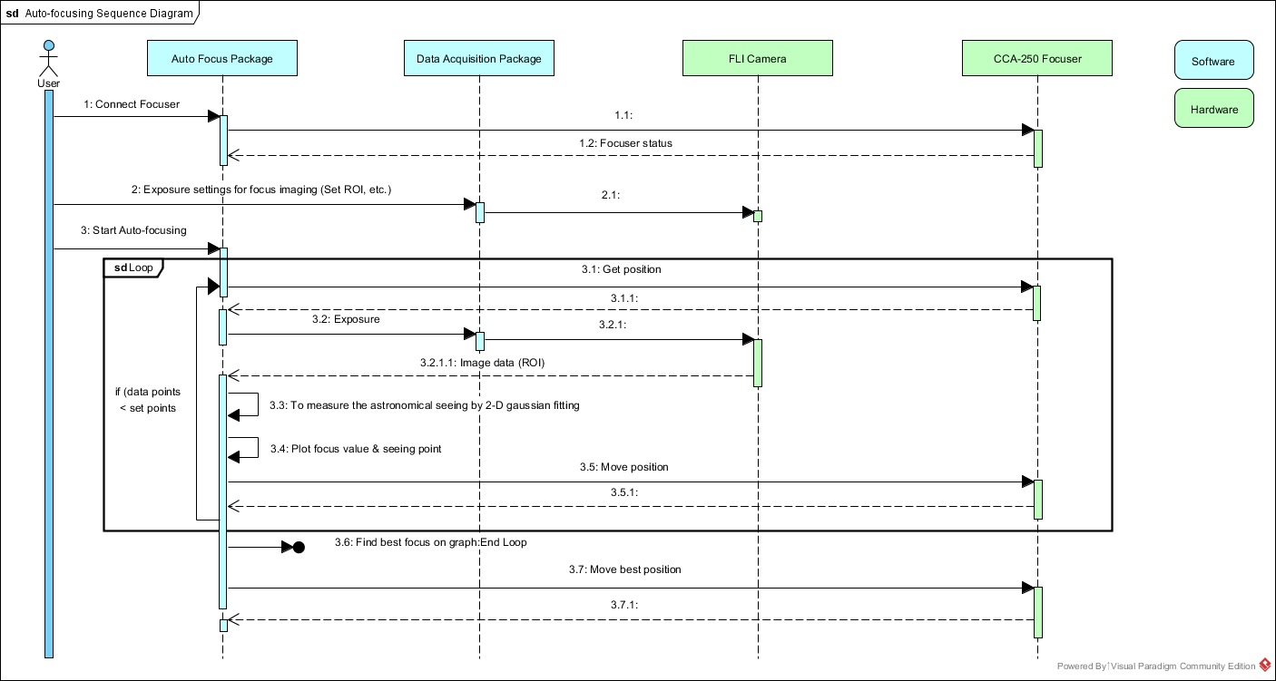
5. Operation Sequence (Auto-Focusing)

Slide 23
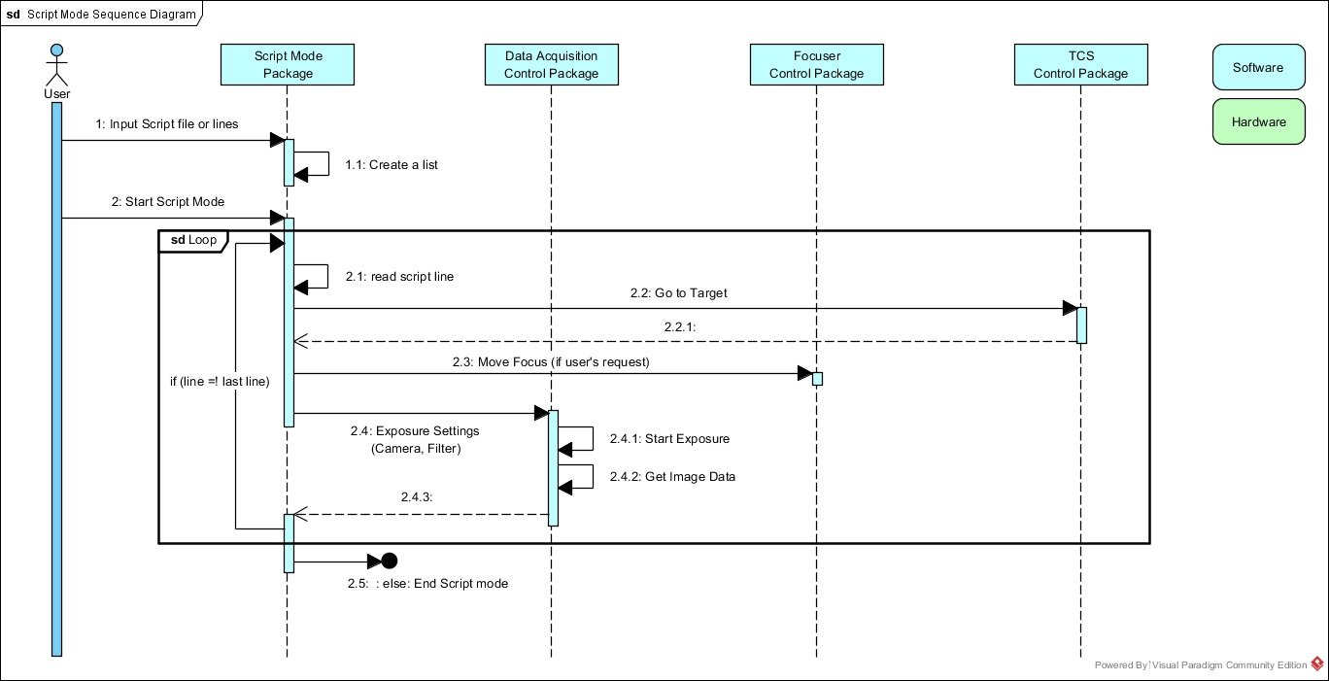
5. Operation Sequence (Script mode)

Slide 24
6. Function Definition
Outline of function definition based on Visual C++ for each package.
Packages | Library |  | MFC Dialog
Telescope Control Package | CLIB_TCS | CLIB_CONTROL | CTelescopeControlDlg
Data Acquisition Package | CLIB_FLI |  | CDataAcquisitionDlg
Auto Focus Package | CLIB_ASCOM |  | CAutoFocusDlg
Script Mode Package |  |  | CScriptModeDlg

Slide 25
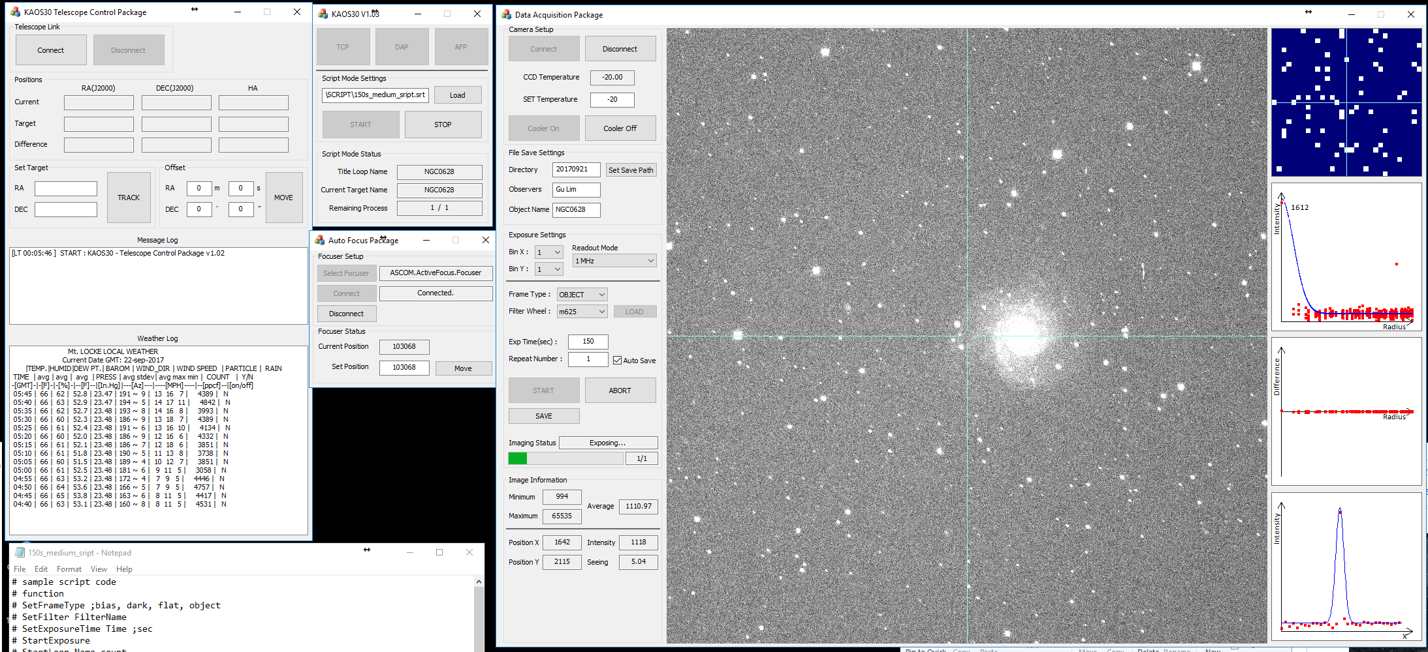
7. Design for Graphical User Interface (GUI)
Overall screen / KAOS30 version 1.03

Slide 26
8. Development History
Date | Progress
2017 Feb 13-19 | ◎ H/W installation (Piggyback system on 30inch Telescope). ◎ S/W driver test for camera, filter wheel and focuser.
2017 Aug 14-19 | ◎ KAOS30 commissioning (focused on DAP, SMP). ◎ Imaging process using script mode successfully operated.
2017 Sep 16-24 | ◎ Improved that functions such as image information. (DAP, SMP) ◎ Test for communication with TCS. (TCP) - Successfully tested to the module for communication with Talon PC. - Connection between TCS and Talon PC is in progress. ◎ Test for Auto-focus. (AFP) - The weather was not good. Sufficient testing is required.

Slide 27
9. Remaining Tasks
KAOS30 Current Version 1.03
Control Package | Tasks | Contents
All | All-1 | Create .dll for Library
TCP | T-1 | Communication with 30inch telescope control system (TCS)
 | T-2 | Automatic alarm and stop process for weather condition
DAP | D-1 | Improve contour map plot
 | D-2 | Rectangular box when clicking on the main image display
AFP | A-1 | Test the auto-focus process
SMP | S-1 | Add offset function
 | S-2 | GUI for remaining process indicator / log

Slide 28
Appendix. A
Naming & Coding Style for Visual C++

Slide 29
Appendix. A : Naming & Coding Style for Visual C++
1. Naming
1) 변수의 명명
(1) 변수의 명명은 아래의 표와 같이 변형된 헝가리언 표기법(Hungarian notation)을 적용한다.

Slide 30
Appendix. A : Naming & Coding Style for Visual C++
1. Naming
(2) 전역변수와 멤버변수는 데이터 형식 앞에 g_, m_ 를 다음과 같이 적용한다.
(3) 변수의 명명에 두 개 이상의 낱말이 쓰이는 경우, 각 단어의 첫 번째 알파벳은 대문자로 한다.

Slide 31
Appendix. A : Naming & Coding Style for Visual C++
1. Naming
2) 함수의 명명
(1) 함수의 명명은 두 개 이상의 낱말이 쓰이는 경우, 단어는 표와 같이 동사 – 주격명사 - 명사의 순서로 한다.
(2) 단어의 첫 번째 알파벳은 대문자로 한다.

Slide 32
Appendix. A : Naming & Coding Style for Visual C++
1. Naming
2) 함수의 명명
(3) GUI 속성의 멤버변수를 설정할 때, 약칭은 다음과 같이 축약한다.

Slide 33
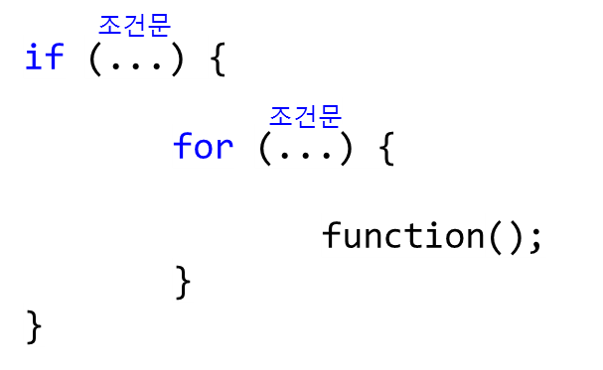
Appendix. A : Naming & Coding Style for Visual C++
2. Coding Style
1) 제어문의 중괄호 작성
if, for, while 등의 제어문을 작성할 때는 K&R 방식으로 다음과 같이 중괄호 { 를 조건문 옆에 작성한다.

Slide 34
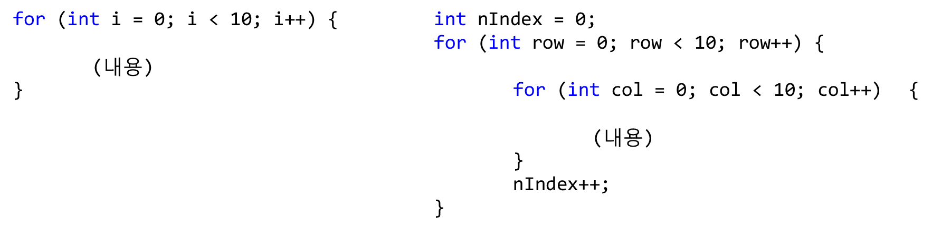
Appendix. A : Naming & Coding Style for Visual C++
2. Coding Style
2) 반복문(loop)에서 사용하는 count를 위한 변수 설정
반복문(for, while 등)에서 사용하는 count를 위한 변수의 경우, 일반적으로 i, k, n, m 등을 사용하나, 중요한 부분이거나 반복문 내부에 반복문이 있을 경우, 변수명에 의미를 부여하는 것이 좋다.
3) 기타사항
(1) class 시작 부분 혹은 거의 초기 단계에서 초기화 변수를 넣어주는 것이 좋다.
(2) 알고리즘을 구현하는 부분과 기능을 구현하는 부분을 나누어서 정리하는 것이 좋다.

Slide 35
Appendix. A : Naming & Coding Style for Visual C++
3. 버전(version) 관리
1) 주석처리
현재 작성중인 코드 버전에, 이전 버전으로부터 추가/변경된 부분이 발생하면 다음과 같이 주석 처리한다.
※ 한 번 정한 name은 바꾸지 말 것.
(예시 1) // add 20170706 by Tae-Geun : 2D Gaussian fit
(예시 2) // change 20170706 by Tae-Geun : pixel array type (int -> double)

Slide 36
Appendix. A : Naming & Coding Style for Visual C++
3. 버전(version) 관리
2) Backup
Backup은 목표로 하는 단계를 달성할 때마다(함수 단위 등) 진행한다. Backup을 할 때의 폴더는 다음과 같이 명명한다.

Slide 37
Appendix. A : Naming & Coding Style for Visual C++
3. 버전(version) 관리
3) 버전(version)
Version의 관리는 다음과 같이 한다.

Slide 38
Appendix. B
Communication between class / dialog / exe

Slide 39
Appendix. B : Communication between class / dialog / exe
1. Define on both
#define WM_MAIN1 WM_USER + 1000
#define WM_MAIN2 WM_USER + 2000
#define WM_SUB WM_USER + 3000
2. Input for receiving
ON_MESSAGE(WM_MAIN1, OnMain1From); //xxx.cpp afx_msg long OnMain1From(WPARAM wParam, LPARAM lParam); //xxx.h long CMFCApplication1Dlg::OnMain1From(WPARAM wParam, LPARAM lParam)
{
~
~
return 0;
}

Slide 40
Appendix. B : Communication between class / dialog / exe
3. Parameter of OnMain1From
int nXXX = (int)wParam, (int)lParam CString *sXXX = (CString*)wParam, (CString*)lParam //but! Impossible between exe and exe. For using, needing to overload by WM_COPYDATA.
4. Input for sending
CWnd* pWnd = FindWidow(NULL, _T("sub package")); //title name of Dialog
if (pWnd != NULL)
pWnd->SendMessage (WM_SUB, (WPARAM) ID_MAIN_1, (LPARAM)&m_sSendMsg);

Slide 41
Appendix. C
Observation log list, Fits file header list

Slide 42
Appendix. C : Observation log list
1. Observation log list
Ex) SQUEAN Observation log
File name | Date-UTC | Time-UTC | Target | RA | Dec | ObsType | ExpTime | Filter | Airmass
20161224_0224.fits | 2016-12-25 | 00:30:11.597276 | Skyflat | 09:01:23 | -03:12:03 | FLAT | 6.00 | m725 | 1.24
20161224_0365.fits | 2016-12-25 | 01:56:24.175402 | Q5_W4_03 | 22:10:04 | +02:54:24 | OBJECT | 60.00 | m675 | 1.61
20161224_0420.fits | 2016-12-25 | 13:05:20.510600 | bias | 00:00:00 | 00:00:00 | BIAS | 0.00 | B | 1.58

Slide 43
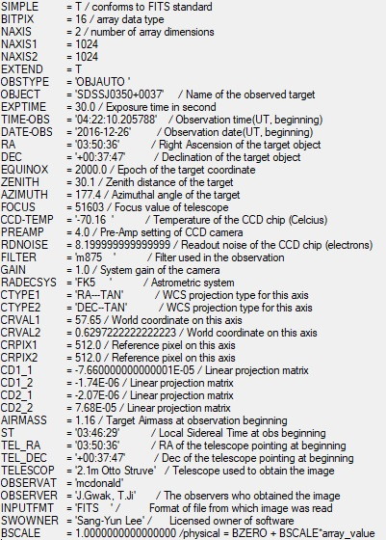
Appendix. C : Fits file header list
2. Fits file header list
Ex) SQUEAN Fits file header list
Not needed

